Slide 1
Conversations for Change: On Improving the Racial Climate at UCI DECEMBER 1, 2020
Tiffany Willoughby-Herard, professor of African American Studies
twilloug@uci.edu
humanitiesequityadvisor@gmail.com
Judy Wu, professor of Asian American Studies and History,
Director of the Humanities Center
j.wu@uci.edu
Yousuf Al-Bulushi, professor of Global and International Studies
Moderator
yalbulus@uci.edu

Slide 2
Three questions
Larger goals of trying to create an anti-racist institution
Specific things we are engaged in
How do we want to invite staff into the process

Slide 3
INITIATIVES & PARTNERSHIPS
PIVOT
LEAD-ABC
AICRE-PHILOSOPHY
HBCU PATHWAYS PROGRAM—ACTIVIST STUDIO WEST
OCEANS-1619 PROJECT
BADAAS
Climate Council (decision making, representation, recognizing excellence in diversity, equity & inclusion)
Distinguished Fellowship

Slide 4
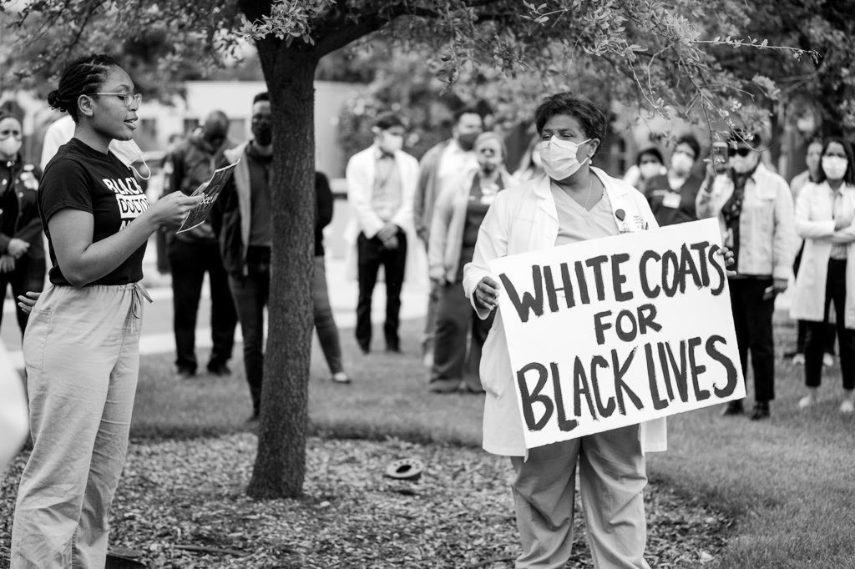
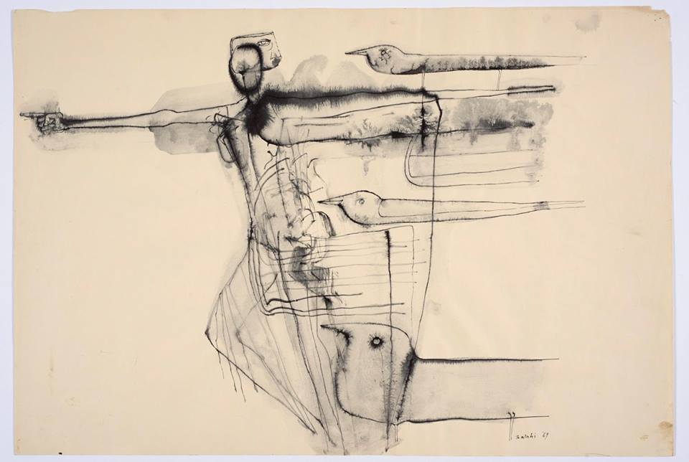
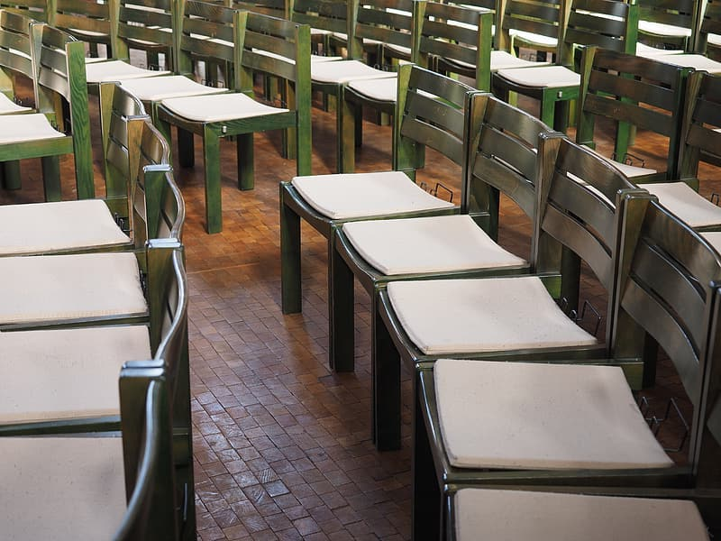
INITIATIVES & PARTNERSHIPS
3+/3+/3+
LEAD-ABC
AICRE+ PHILOSOPHY
CLIMATE COUNCIL
By His will we teach the birds to fly no. 4 (Object), 1969, by Ibrahim El-Salahi

Slide 5
THE SOUND OF CHANGE
https://soundcloud.com/theucipodcast/how-the-lead-abc-program-gives-black-medical-students-a-powerful-voice

Slide 6
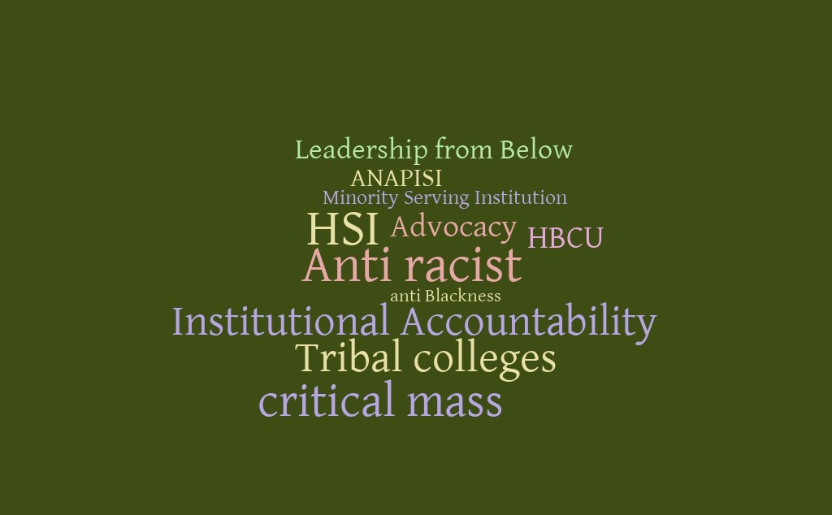

Slide 7
RESOURCES
The beginnings of activism for the department of Asian American Studies (BADAAS) https://sites.uci.edu/badaas/
UCI Diversity Affinity groups: https://www.oeod.uci.edu/resources/affinity/php
“Patsy Mink blazed the trail for Kamala Harris” https://www.civilbeat.org/2020/11/how-hawaiis-patsy-mink-blazed-the-political-trail-for-kamala-harris/
X:BLACK WOMEN DAILY https://www.facebook.com/ucixbwd/ OCEANS-1619 https://www.humanities.uci.edu/humanitiescenter/programs/oceans.php AICRE-PHILOSOPHY https://sites.uci.edu/aicre/aicrephilosophy-2/ AICRE-PISAB https://sites.uci.edu/aicre/files/2018/10/Concrete-Impacts-of-the-Undoing-Racism-Workshop.pdf LEAD-ABC Here's the sample sound: Start to Beginning to 8:40 https://news.uci.edu/2020/06/16/uci-podcast-how-the-lead-abc-program-gives-black-medical-students-a-powerful-voice/ ACTIVIST STUDIO WEST: A DIGITAL REPOSITORY OF MOVEMENT MATERIAL https://sites.uci.edu/activiststudiowest/

